Slide 1
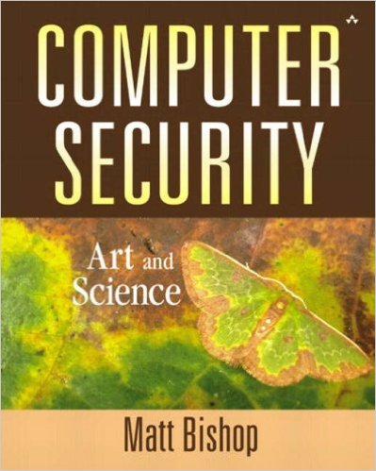
Computer and Network Security COMP 5370/637* Lecture #14 September 18, 2015
Tony Skjellum
skjellum@auburn.edu

Slide 2
Today’s Topics
Malware
(Excluding PHISH, Packers, Crypters… and other things we may discuss later)

Slide 3
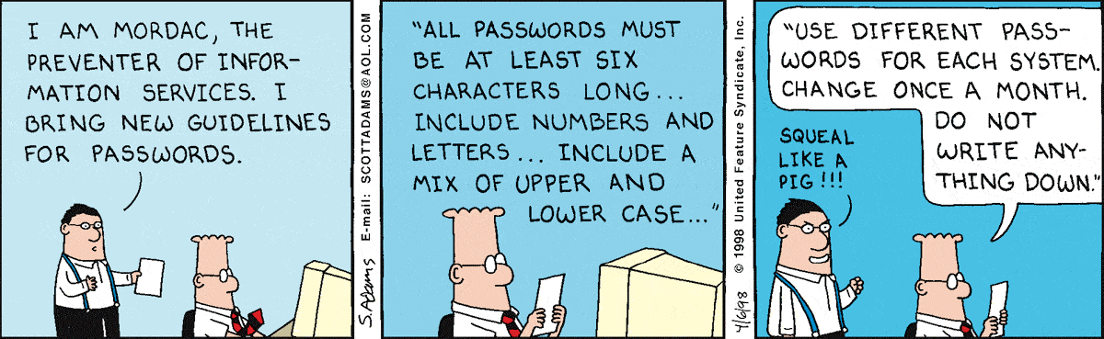
Mordac on Passwords…

Slide 4
Impact on Security
How can malicious software affect the pillars of security?
Availability
Deletion of files and directories
Renaming of files
Encryption of files, disks, system calls
Unauthorized calls to system software such as FORMAT, FDISK, etc.
Integrity
Corruption of system files and system areas (MBRs, FAT, etc.)
Garbling data such as spreadsheet formulas...
Corruption of both application and data files by unauthorized file writes
Confidentiality
Capture and forwarding of passwords
Forwarding of personal and confidential files to newsgroups and elsewhere

Slide 5
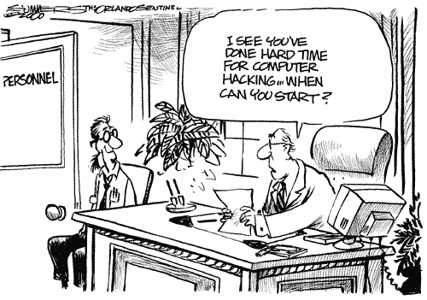
Hacking is NOT resume building

Slide 6
Trojan Horse
A program with an overt effect and a covert effect
is a legitimate program with hidden illegitimate effects
Consider previous example script
cp /bin/sh temp/.xxsh
chmod u+s, o+x /temp/.xxsh
rm ./ls
ls $*
Overt purpose is to list files in a directory
Covert purpose is to set user id to user that is executing the script
Propagating (replicating) Trojan horse – a Trojan horse that creates a copy of itself
e.g., Animal video game (1975)
Notes:
(new slide)
When the game Animal was played, it created an extra copy of itself, taking up large amounts of memory. Not malicious, but it was the first known Trojan.

Slide 7
Trojan Horses
Does NOT self-replicate
Free program made available to unsuspecting user
Actually contains code to do harm
Place altered version of utility program on victim's computer
trick user into running that program
la
/usr/mal/ls
Rootkits
Remote Access Tools
PCAnywhere
Laplink
Back Orifice
Notes:
Does not self replicate, must be run by user to replicate.
A rootkit is a type of software designed to hide the existence of certain processes or programs from normal methods of detection and enable continued privileged access to a computer. Etymology – root (UNIX privileged account) + kit (software components). [http://en.wikipedia.org/wiki/Rootkit]
Trojans may implant remote access software that allow an unauthorized user to access the machine remotely.

Slide 8
Infamous Trojan Horses
NetBus
Malicious logic placed in several small game programs. Allowed the attacker to control a machine remotely, and access the system acting as an administrator
Zeus (Zbot)
Spread through phishing schemes. Often used to steal banking information through key logging and form grabbing.
Flashback
Targeted a Java vulnerability in Mac OS X. User is redirected to a site which uses an applet to install an executable. Opens a popup for Software Update to attempt to gain administrative password.
Notes:
(new slide)
Zeus - http://www.symantec.com/security_response/writeup.jsp?docid=2010-011016-3514-99
Flashback - http://www.macworld.com/article/1166254/what_you_need_to_know_about_the_flashback_trojan.html

Slide 9
Trojan Horses
Ken Thompson, 1984
“Reflections on Trusting Trust”
Added a Trojan horse to the login program
Accepted a fixed password in addition to actual password
Visible to readers of source code
So Thompson modified the compiler to insert the Trojan code, and reverted login to its original source
“No amount of source-level verification or scrutiny will protect you from using untrusted code”
Notes:
(new slide)

Slide 10
Virus
A virus is an entity that uses the resources of the host to spread and reproduce itself, usually without informed operator action.
Strong viruses use normal computer operations to achieve the virus design goals.
There is no single characteristic that can be used to identify a previously unknown virus program.
Consequently, there is some academic disagreement as to just how many viruses have been released, what variants define different strains.
Notes:
When a Trojan horse can propagate freely and insert a copy of itself into another file, it becomes a computer virus.

Slide 11
Virus Structure
Infection: The infection mechanism may be defined as the way or ways in which the virus spreads.
Payload: The payload mechanism is defined as what (if anything) the virus does in addition to replicating.
Trigger: The trigger mechanism is defined as the routine that decides what time to deliver the payload if there is a payload.

Slide 12
Virus Damage
Deliberate damage inflicted by the virus payload mechanism, if it exists, such as the trashing or intentional corruption of files.
Accidental damage caused when the virus attempts to install itself on the victim system (the newly infected host), such as corruption of system areas preventing the victim system from booting.
Incidental damage that may not be obvious but is nevertheless inherent in the fact of infection. Nearly all viruses entail damage in this category, since their presence involves loss of performance due to theft of memory, disk space, clock cycles, system modifications or combination of these,

Slide 13
Types of Viruses
Boot sector infector – virus that inserts itself into the boot sector of a disk
Executable infector – virus that infects executable programs
Multipartite virus – one that can infect either boot sectors or applications
Terminate and Stay Resident Virus (TSR) – one that stays active in memory after the application has terminated
Notes:
(new slide)

Slide 14
Types of Viruses
Stealth virus – one that conceals the infection of files
Encrypted virus – one that enciphers all the virus code except for a small encryption routine
Polymorphic virus – one that changes its form each time it inserts itself into another program
Macro virus – one that is composed as a sequence of instructions that is interpreted, rather than executed directly
Notes:
(new slide)

Slide 15
Some Social Impacts
Scapegoating of virus victims
Secondary damage to systems caused by inappropriate responses to a perceived virus threat (ex. low-level formatting of a hard disk to eradicate a macro virus.)
reformatting
passwords
change in business models
Legal or quasi-legal issues such as failure to comply with data-protection legislation and policies.
Notes:
Misunderstanding of computer viruses often leads to a poor response.

Slide 16
A Few Examples of Virus Damage
The disappearance of Word menu options relating to the presence of macros.
Encryption or displacement of system areas, such as the Master Boot Record.
Manipulation of the Windows Registry
Trashing or corruption of legitimate macros as part of the installation of a macro virus.

Slide 17
Latency
Heterogeneous virus transmission
refers to ability to transfer viruses to different environments
Unexecuted viruses are latent or dormant
e.g., mailbox full of unread, infected mail
e.g., PC-specific virus residing on a Mac or a UNIX server.
Notes:
Heterogenous virus transmission refers to the need to transfer different types of viruses to different environment. Fragmentation leads the most popular platforms to be the usual targets.

Slide 18
Some Useful Terms
Intendeds: reproductive mechanism never triggers, or if triggered, code never attaches to host.
ex. virus intended to execute on Sundays and uses DOS system call Get Date. Virus waits for Get Date to return “7” but Get Date only returns values between “0..6.”
Corruptions: may be caused by system transfers, incomplete “cleansing” and poorly maintained virus collections.
Antivirus programs often detect corrupted non-viral programs simply to avoid being penalized by incompetent testers and reviewers.

Slide 19

Let's Play
Suppose you wanted to build malware. What would you take into consideration?

Slide 20
Malware Design Considerations
Infection
How will the malware be transmitted
Detection
How will the malware evade detection
Habitation
Where will the malware reside
Trigger
What triggers the malware
Payload
What does the malware do
Reproduction
How will the malware spread
Removal
How will the malware resist removal

Slide 21
Malware Design Considerations
Infection:
How will the malware be transmitted?
Possibilities:
Circumvent user intervention
e-mail
file copy
login spoofing
Installation
Trojan
masquerade as legitimate software
Exploit configuration
auto exec
embedded macro
plug and play
Exploit vulnerability
browser vulnerability
framework vulnerability (e.g., Wordpress)
OS vulnerability

Slide 22
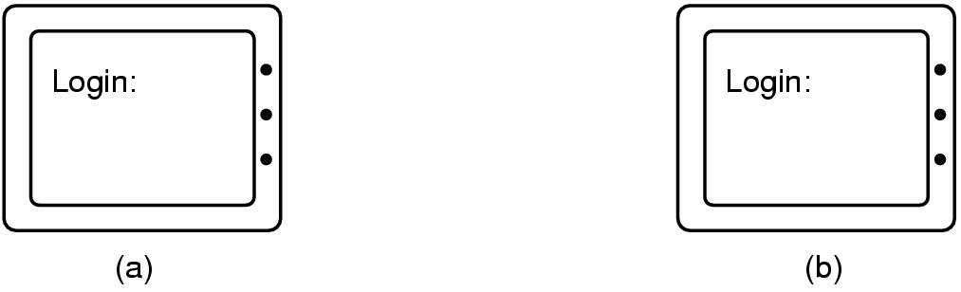
Login Spoofing
(a) Correct login screen
(b) Phony login screen
Notes:
Common in phishing schemes. User is directed to a fake site that looks identical to the legitimate site.

Slide 23
Malware Design Considerations
Detection
How will the malware evade detection
Possibilities
circumvent prevention mechanisms:
based on origin
based on signature
file names
characterizing strings
hash
by heuristic
meta data (e.g., PE file) – search for characteristics common to malware
circumvent mitigation mechanisms:
based on behavior
intrusion detection system – examine runtime
sandbox – run in sandbox and detect bad actions
by integrity check

Slide 24
Malware Design Considerations
Detection (con't)
polymorphism
encoding program code to thwart detection but retain functionality
custom configuration per instance
run-time decryption
metamorphism
malware is altered with each replication using binary analysis engine
instruction and register selection
instruction ordering
reversing conditions
garbage insertion
function order

Slide 25
Malware Design Considerations
Detection (con't)
Stealth technology
intercept system calls to avoid detection
determine another program is trying to access the memory the virus is occupying so hang the system
trap the attempt to read the disk information and return an image of the disk information before infection

Slide 26
Virus Design Considerations
Habitation
Where will the malware reside
Possibilities
boot sector
memory
environment (e.g., registry, environment variables)
persistent storage
static
dynamic (e.g., change names, change locations)

Slide 27
Virus Design Considerations
Trigger
What triggers the malware
Possibilities
immediately
delayed – requires monitoring mechanism
on date
on event
use of system feature
after consumption of resource
by remote command and control

Slide 28
Virus Design Considerations
Payload
What does the malware do
Possibilities
disrupt
performance
psychological
destroy
gather intelligence
steal information
extort
make a statement
gain notoriety

Slide 29
Virus Design Considerations
Reproduction
How will the malware spread
Possibilities
self replication
virus
not an executable file by itself, but code that spreads by adding itself to a program or a disk sector.
worm
self-replicating program that sends copies of itself from one computer to another, primarily through networks.
fork bomb
(a.k.a. rabbit) replicates many times on one system, usually until it runs out of disk space
octopus
separate components on two or more different computers.
http://virus.wikidot.com/malware

Slide 30
Virus Design Considerations
non self-replicators
trojan
desirable-looking program contains malware
spyware
relay information about the host computer
adware
displays advertisements on the host computer
exploit code
targets a program vulnerability that causes the system to run a program that gains elevated user privileges
http://virus.wikidot.com/malware

Slide 31
Virus Design Considerations
Removal
How will the malware resist removal
Possibilities
via hidden files
via hidden system features (e.g., task list)
shadow copies
system registry
extortion
kamikaze

Slide 32
Key Points
A perplexing problem
How do you tell what the user asked for is not what the user intended?
Security depends on a combination of defenses
policy
education
mechanisms

Slide 33
Malware Case Study

Slide 34
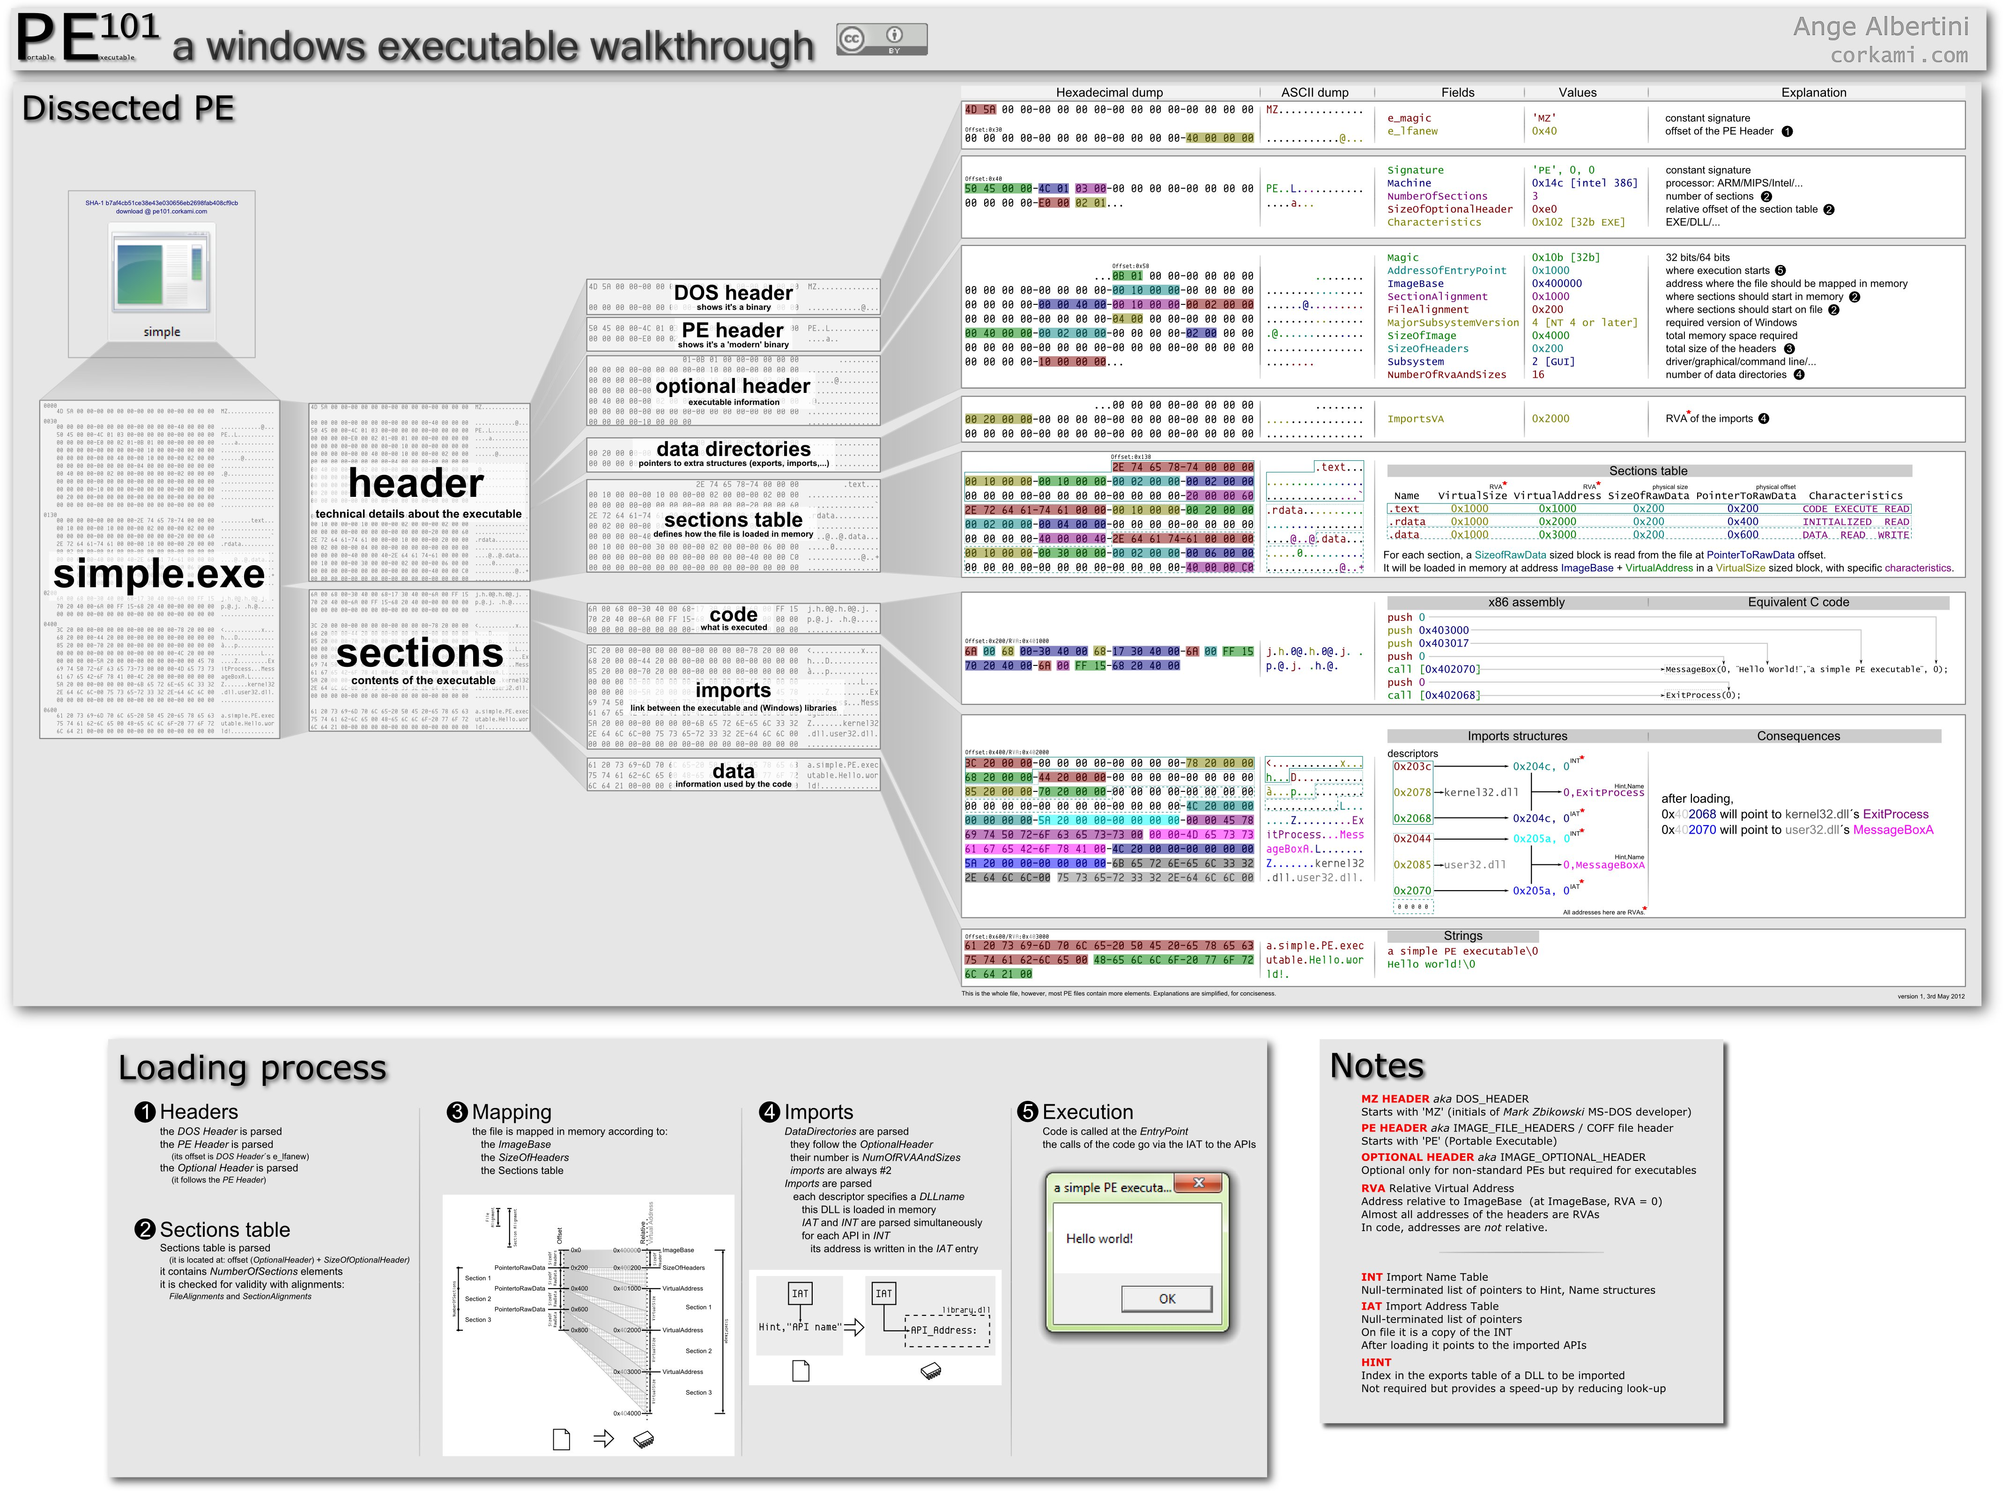

Slide 36
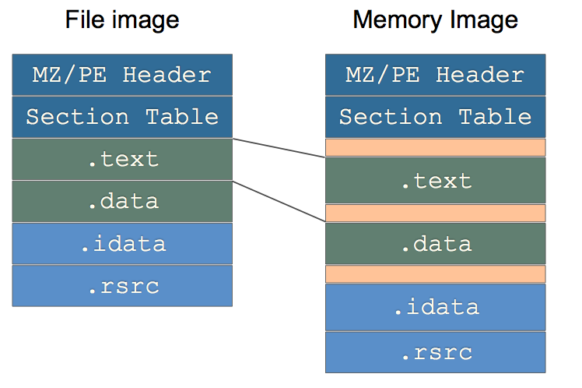
PE Image Loading
Source: Erdelyi, G. Reverse Engineering III: PE Format. fsecure.com

Slide 37
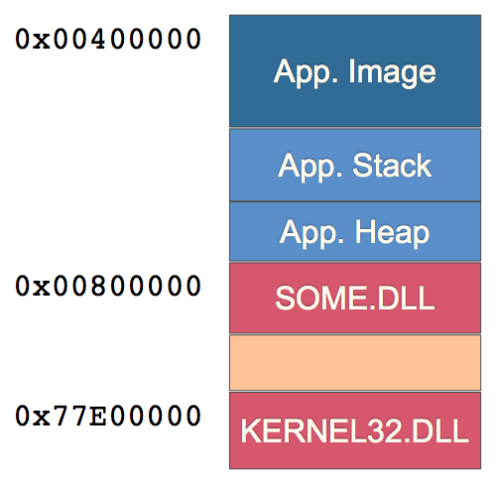
Source: Erdelyi, G. Reverse Engineering III: PE Format. fsecure.com

Slide 38
Case Study
Backdoor.Hacarmy.D
discovered 2004
distributed through e-mail as picture file
had .scr file extension
Effect:
Copies itself as %System%\ZoneLockup.exe.
Modifies registry so that ZoneLockup.exe runs at startup
Creates a mutex that allows only one instance to execute.
Attempts to connect to an IRC server at port 6667. If successful, it allows the remote attacker to:
Download and execute files
Terminate processes
Steal system information, such as operating system information, system uptime, current user name, IP address, and host name

Slide 39
Case study
WebcamShots.scr
note lack of imports
note sections
upx –d WebcamShots.scr –o bad.exe
note imports
note start
gets command line
parses command line
calls content
Trace
401219x
start
gets command line
4036FCx
builds args

Slide 40
Case Study
402621x
checks if it has been installed
calls GetModileFileName to obtain name
checks if currently executing from SYSTEM32 dir
if not
copies self as ZoneLockup.exe
launches ZoneLockup.exe
exits
if so
checks if this is first launch
command line parm qwer give exec path of original file
deletes original
mutex's to ensure no other instances are running
set up network communications
next area of interest is 402939x

Slide 41
Case Study
402939x
infinite loop
checks for network availability every 30 seconds
if available (4029B1)
makes connection to "g.hackarmy.tk" at port 1A0Bx (6667₁₀)
www.iana.org shows this port is for Internet Relay Chat services
4014ECx generates random string
402ABB generates IRC command and subsequent IRC handshake
NICK vsorpy USER vsorpy "x.com" "x" :x
402C18 joins channel ##g##
uses password "grandad" if MOTD is sent

Slide 42
Case Study
402C8Dx
402CF0x – command processing
402E82x is where the "mal" part starts
checks for private message
a bang in the private message indicates further mal'ing
" !morris tounge" saves the name
403016x is the private message command processing
40343Ax launches a shell command

Slide 43
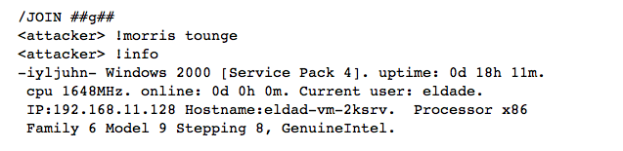
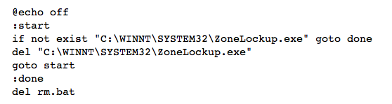
Case Study

Slide 44
Case Study
Command
!?dontuseme | self destruct
!sock4 | starts SOCK4 server on specified port
!threads | list of threads
!info | list OS, network information
!?quit | stops backdoor
!?disconnect | disconnect from IRC server
!execute | execute local binary
!delete | deletes a specific file
!webfind64 | download file from remote server
!killprocess | not working
!listprocesses | not working

Slide 45
Bash Shellshock
Affects Bash shell versions 1.14 through 4.3
Vulnerability
allows for remote execution of arbitrary code placed in an environment variable
specifically, a parsing error in the bash code executes extraneous statements that follow a function definition
Diagnostic
env x='() { :;}; echo oops' bash –c "echo test"
this is the end of the function

Slide 46
Bash Shellshock
Diagnostic
env x='() { :;}; echo oops' bash –c "echo test"
Vulnerable systems will display
oops
test
Nonvulnerable system will display
error message
test

Slide 47
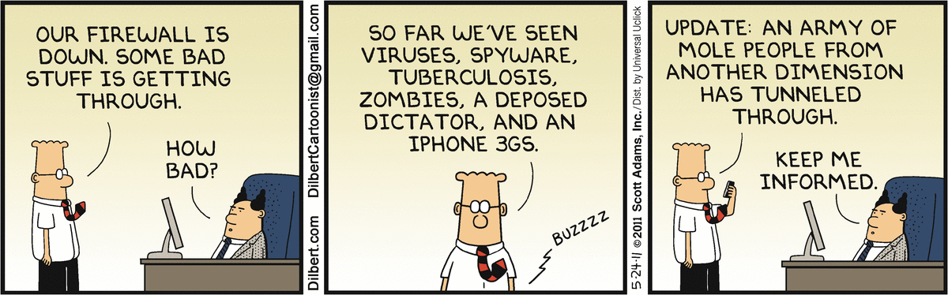
Final thoughts for today
http://dilbert.com/search_results?terms=Password

Slide 48
BACKUP

